Slide 1

Sequence-to-Sequence
Timo Wang

Slide 2
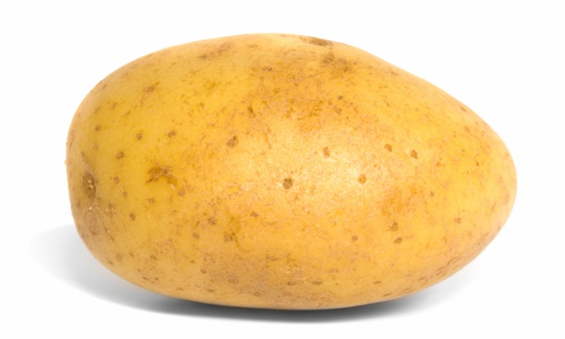


Slide 3
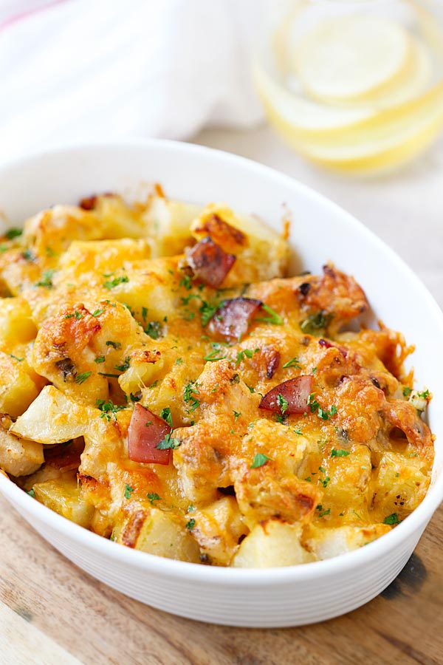

Slide 7
Chopper & Chef
X
Y
Chopper
Chef
Prep Cookware
t=0
t=1
t=2
t=3
t=4
Notes:
Explain how to train an encoder decoder network in the sense how well chopping is done and how well cooking is done.

Slide 8
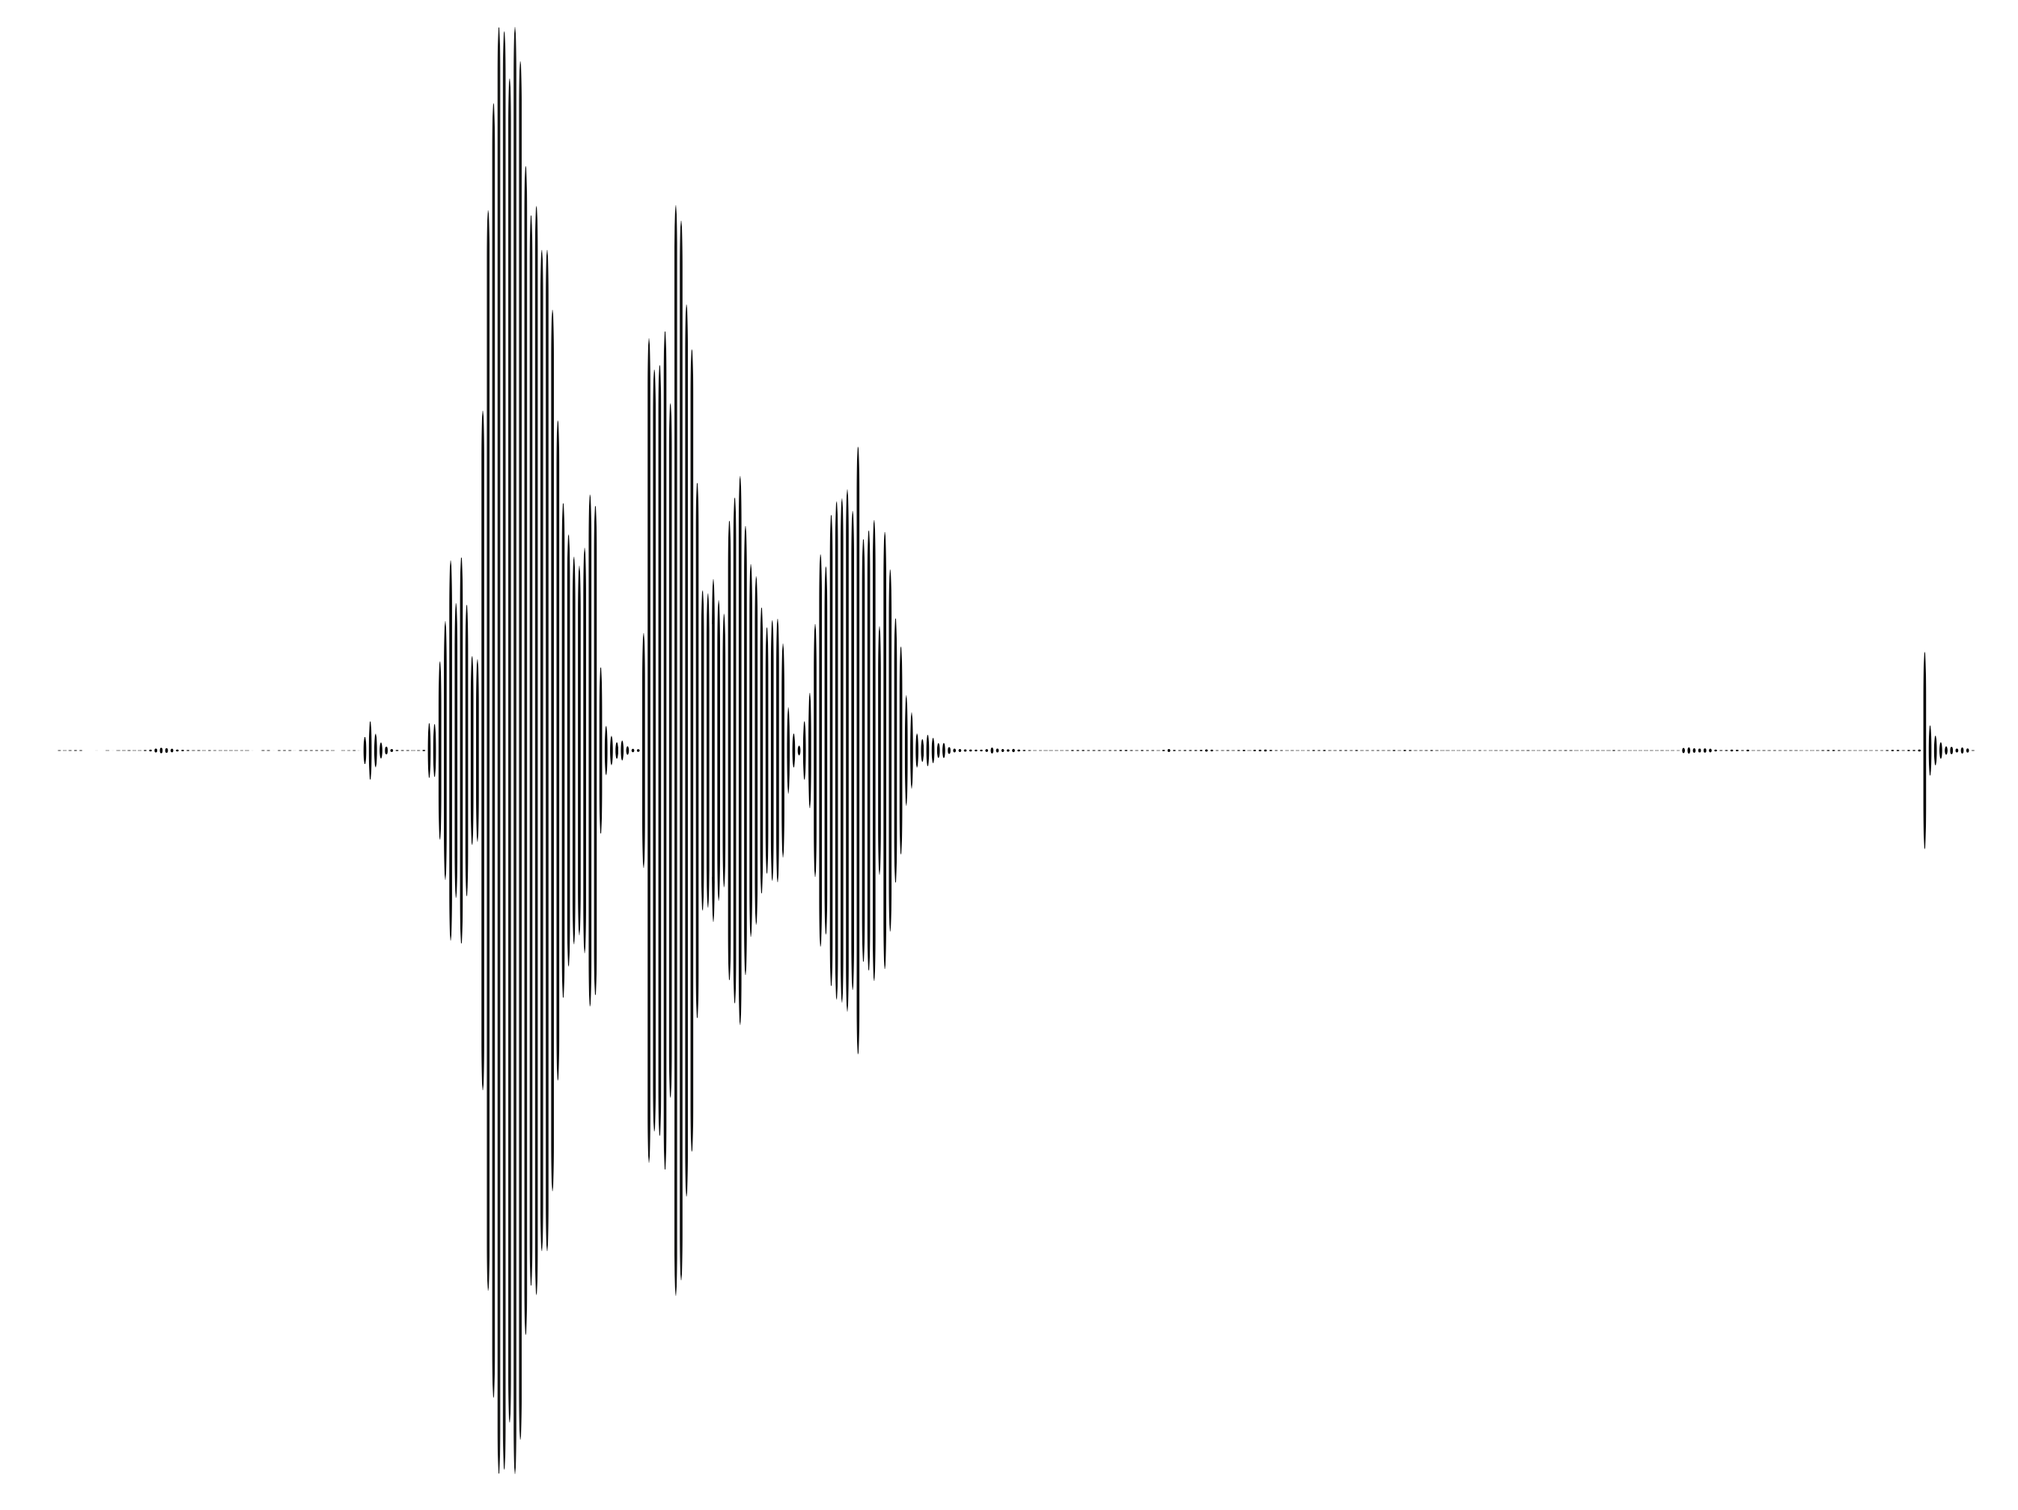
Seq2Seq
X
Y
Chopper
Chef
Translator
How are you
Wie geht’s
Transcriber
How are you

Slide 9
Limitations

Slide 10
Limitations

Slide 11
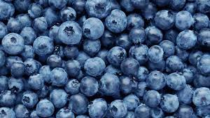
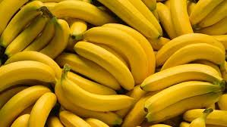
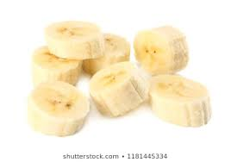
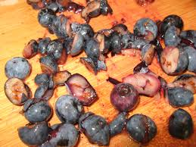
Limitations

Slide 12
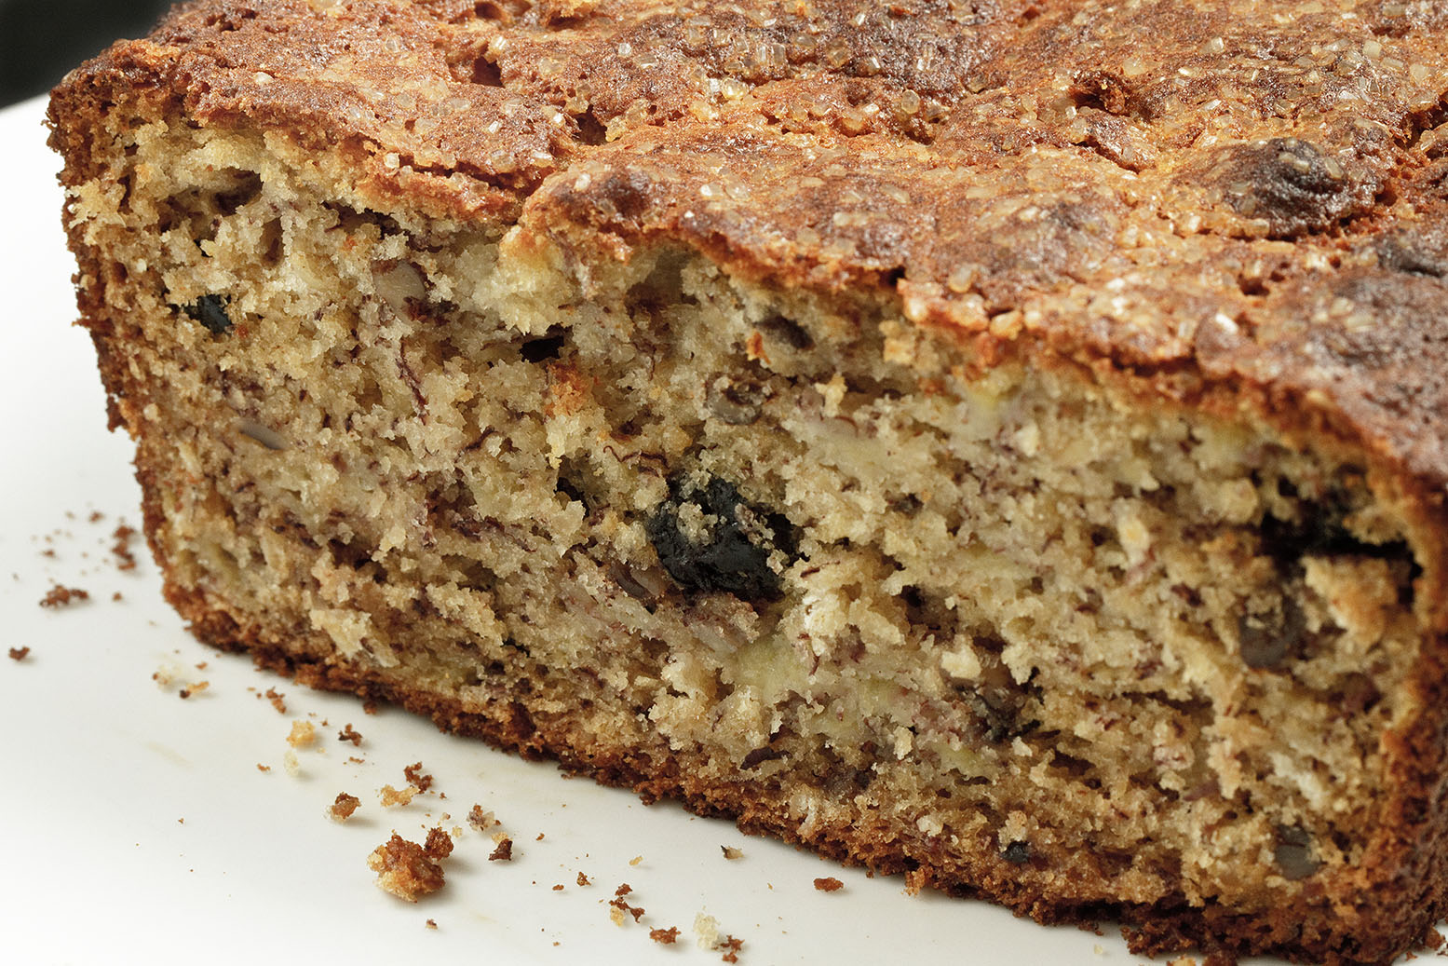
Limitations

Slide 13
Improved Approach

Slide 14
Improved Approach

Slide 15
Improved Approach

Slide 16
Improved Approach

Slide 17
Even Better

Slide 19
Even Better

Slide 20


Slide 21
Encoder & Decoder
X
Y
Encoder
Decoder
How
are
you
<EOS>
Wie
geht’s
<EOS>
How
are
you
t=0
t=1
t=2
t=3
t=4
t=5

Slide 22
Limitations
The apple, after being cut into pieces, has turned brown.
The apple, after being cut into pieces, has turned brown.
The apple, after being cut into pieces, has turned brown.

Slide 23
LSTM Concept
The
apple
after
being
cut
has
turned
brown
The
apple
after
being
cut
has
turned
brown
t=0
t=1
t=2
t=3
t=4
t=5
t=6
t=7

Slide 24
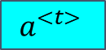
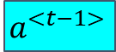
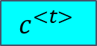
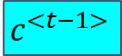
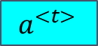
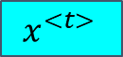
Long Short-Term Memory Unit
$$a^{<t>}$$
$$c^{<t−1>}$$
Multiply
Add
$$c^{<t>}$$
Multiply
tanh
tanh
sigmoid
sigmoid
sigmoid
$$a^{<t−1>}$$
Concat
Multiply
$$a^{<t>}$$
$$x^{<t>}$$
Notes:
It remembers and forgets part of the information from the past.

Slide 25
LSTM Unit
$$a^{<t−1>}$$
Concat
$$x^{<t>}$$

Slide 26
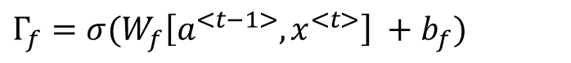
LSTM Unit
sigmoid
$$a^{<t−1>}$$
Concat
$$x^{<t>}$$
$$Γ_{f}=σ(W_{f}\left[a^{<t−1>}, x^{<t>}\right] +b_{f})$$

Slide 27
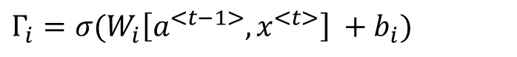
LSTM Unit
sigmoid
sigmoid
$$a^{<t−1>}$$
Concat
$$x^{<t>}$$
$$Γ_{i}=σ(W_{i}\left[a^{<t−1>}, x^{<t>}\right] +b_{i})$$

Slide 28
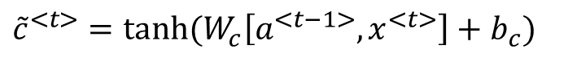
LSTM Unit
tanh
sigmoid
sigmoid
$$a^{<t−1>}$$
Concat
$$x^{<t>}$$
$${\tilde{c}}^{<t>}=\tanh{(W_{c}\left[a^{<t−1>}, x^{<t>}\right]+b_{c})}$$

Slide 29
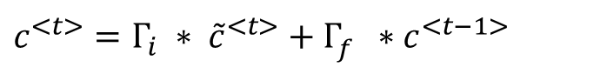
LSTM Unit
$$c^{<t−1>}$$
Multiply
Add
$$c^{<t>}$$
Multiply
tanh
sigmoid
sigmoid
$$a^{<t−1>}$$
Concat
$$x^{<t>}$$
$$c^{<t>}=Γ_{i} ∗ {\tilde{c}}^{<t>}+Γ_{f}^{}∗c^{<t−1>}$$

Slide 30
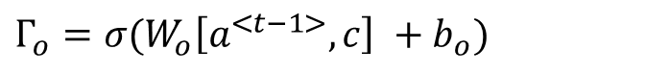
LSTM Unit
$$c^{<t−1>}$$
Multiply
Add
$$c^{<t>}$$
Multiply
tanh
sigmoid
sigmoid
sigmoid
$$a^{<t−1>}$$
Concat
$$x^{<t>}$$
$$Γ_{o}=σ(W_{o}\left[a^{<t−1>}, c\right] +b_{o})$$

Slide 31
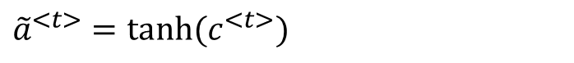
LSTM Unit
$$c^{<t−1>}$$
Multiply
Add
$$c^{<t>}$$
Multiply
tanh
tanh
sigmoid
sigmoid
sigmoid
$$a^{<t−1>}$$
Concat
$$x^{<t>}$$
$${\tilde{a}}^{<t>}=\tanh{(c^{<t>})}$$

Slide 32
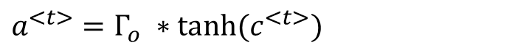
LSTM Unit
$$a^{<t>}$$
$$c^{<t−1>}$$
Multiply
Add
$$c^{<t>}$$
Multiply
tanh
tanh
sigmoid
sigmoid
sigmoid
$$a^{<t−1>}$$
Concat
Multiply
$$a^{<t>}$$
x_{t}
$$a^{<t>}=Γ_{o} ∗\tanh{(c^{<t>})}$$

Slide 33
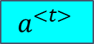
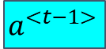
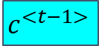
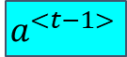
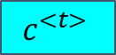
LSTM
$$a^{<t−1>}$$
$$a^{<t>}$$
o_{t}
m_{t-1}
Multiply
Add
m_{t-1}
Multiply
Add
Multiply
Add
$$c^{<t−1>}$$
m_{t}
$$c^{<t>}$$
m_{t}
Multiply
Multiply
Multiply
tanh
tanh
tanh
tanh
tanh
tanh
sigmoid
sigmoid
sigmoid
sigmoid
sigmoid
sigmoid
sigmoid
sigmoid
sigmoid
o_{t-1}
Concat
Multiply
o_{t-1}
Concat
Multiply
Concat
Multiply
$$a^{<t−1>}$$
o_{t}
$$a^{<t>}$$
o_{t}
i_{t}
$$x^{<t>}$$
i_{t}
Notes:
Dilution of information in the hidden state. Encoding a whole thing into a context vector, ..., diluted, lost, messy encoding, when you're generating the sequence, you further update the context vector, and this adds to the dilution. Complex dependencies involving information from multiple words makes it even harder to reconstruct meanings.
Bengio Bidirectional -- As clearly visible from Fig. 2 the proposed model (RNNsearch) is much better than the conventional model (RNNencdec) at translating long sentences. This is likely due to the fact that the RNNsearch does not require encoding a long sentence into a fixed-length vector perfectly, but only accurately encoding the parts of the input sentence that surround a particular word.
Entity-Relation-Properties, -- combinatorial space is large -- hard to encode
Attention -- go back to the original sentence to find what's needed -- only encode relationships

Slide 34
Seq2Seq
Encoder
Decoder
How are you
Wie geht es dir
Notes:
Review Seq2Seq model. Revisit how it works.

Slide 35
Problem with Vanilla Seq2Seq
Encoder
Decoder
How are you
Wie geht es dir
Fixed-Length Vector
Notes:
Dilution of information in the hidden state. Encoding a whole thing into a context vector, ..., diluted, lost, messy encoding, when you're generating the sequence, you further update the context vector, and this adds to the dilution. Complex dependencies involving information from multiple words makes it even harder to reconstruct meanings.
Bengio Bidirectional -- As clearly visible from Fig. 2 the proposed model (RNNsearch) is much better than the conventional model (RNNencdec) at translating long sentences. This is likely due to the fact that the RNNsearch does not require encoding a long sentence into a fixed-length vector perfectly, but only accurately encoding the parts of the input sentence that surround a particular word.
Entity-Relation-Properties, -- combinatorial space is large -- hard to encode
Attention -- go back to the original sentence to find what's needed -- only encode relationships

Slide 36
Problem with Vanilla Seq2Seq
Gibberish!
Encoder
Decoder
Neuronale maschinelle Übersetzung ist ein kürzlich vorgeschlagener Ansatz zur maschinellen Übersetzung. Anders als bei der herkömmlichen statistischen maschinellen Übersetzung zielt die neuronale maschinelle Übersetzung darauf ab, ein einzelnes neuronales Netzwerk aufzubauen, das gemeinsam optimiert werden kann, um die Übersetzungsleistung zu maximieren. Die kürzlich vorgeschlagenen Modelle für die maschinelle maschinelle Übersetzung gehören häufig zu einer Familie von Encoder-Decodern und codieren einen Quellsatz in einen Vektor fester Länge, aus dem ein Decodierer eine Übersetzung generiert. In diesem Artikel vermuten wir, dass die Verwendung eines Vektors mit fester Länge einen Engpass bei der Verbesserung der Leistung dieser grundlegenden Encoder-Decoder-Architektur darstellt, und schlagen vor, diese zu erweitern, indem ein Modell die automatische (Soft-) Suche nach Teilen ermöglicht eines Quellsatzes, die für die Vorhersage eines Zielworts relevant sind, ohne dass diese Teile explizit als hartes Segment gebildet werden müssen. Mit diesem neuen Ansatz erreichen wir eine Übersetzungsleistung, die mit dem bestehenden, auf dem neuesten Stand der Technik basierenden, auf Phrasen basierenden System für die Aufgabe der Übersetzung Englisch-Französisch vergleichbar ist. Darüber hinaus zeigt die qualitative Analyse, dass die (weichen) Ausrichtungen des Modells gut mit unserer Intuition übereinstimmen.
Neural machine translation is a recently proposed approach to machine transla- tion. Unlike the traditional statistical machine translation, the neural machine translation aims at building a single neural network that can be jointly tuned to maximize the translation performance. The models proposed recently for neu- ral machine translation often belong to a family of encoder–decoders and encode a source sentence into a fixed-length vector from which a decoder generates a translation. In this paper, we conjecture that the use of a fixed-length vector is a bottleneck in improving the performance of this basic encoder–decoder architec- ture, and propose to extend this by allowing a model to automatically (soft-)search for parts of a source sentence that are relevant to predicting a target word, without having to form these parts as a hard segment explicitly. With this new approach, we achieve a translation performance comparable to the existing state-of-the-art phrase-based system on the task of English-to-French translation. Furthermore, qualitative analysis reveals that the (soft-)alignments found by the model agree well with our intuition.
Fixed-Length Vector
Notes:
Dilution of information in the hidden state. Encoding a whole thing into a context vector, ..., diluted, lost, messy encoding, when you're generating the sequence, you further update the context vector, and this adds to the dilution. Complex dependencies involving information from multiple words makes it even harder to reconstruct meanings.
Bengio Bidirectional -- As clearly visible from Fig. 2 the proposed model (RNNsearch) is much better than the conventional model (RNNencdec) at translating long sentences. This is likely due to the fact that the RNNsearch does not require encoding a long sentence into a fixed-length vector perfectly, but only accurately encoding the parts of the input sentence that surround a particular word.
Entity-Relation-Properties, -- combinatorial space is large -- hard to encode
Attention -- go back to the original sentence to find what's needed -- only encode relationships

Slide 37
Attention (Example)
A giant apple falls
天 上 掉 下 个 大 苹 果
Notes:
Better Idea (than seq2seq):
Draw information from the original sentence when translating

Slide 38
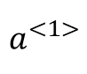
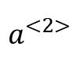
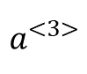
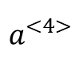
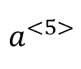
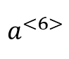
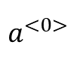
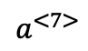
Attention (Intuition)
$$a^{<7>}$$
Ich
komme
am
Abend
in
München
an
I
come
this
evening
in
Munich
to
ankommen - arrive
Notes:
Better Idea (than seq2seq):
Draw information from the original sentence when translating

Slide 39
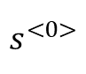
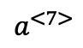
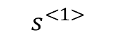
Attention (Intuition)
I
$$s^{<1>}$$
Attention Magic
$$a^{<7>}$$
Ich
komme
am
Abend
in
München
an
I
come
this
evening
in
Munich
to
ankommen - arrive
Notes:
Better Idea (than seq2seq):
Draw information from the original sentence when translating

Slide 40
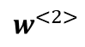
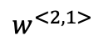
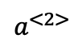
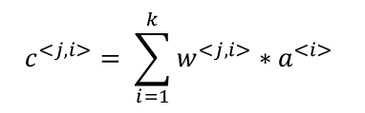
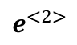
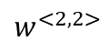
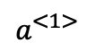
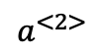
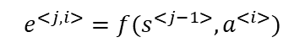
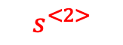
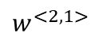
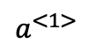
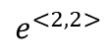





I
arrive
$$s^{<1>}$$
$$s^{<2>}$$
arrive
Step 1
$$e^{<j, i>}=f(s^{<j−1>}, a^{<i>})$$
Step 2
$$w^{<j>}=softmax(e^{<j>})$$
Step 3
$$c^{<j, i>}= \sum_{i=1}^{k}{w^{<j, i>}∗a^{<i>} }$$
c2
$$e^{<2,1>}$$
$$e^{<2,2>}$$
…
$$e^{<2>}$$
Add
…
$$s^{<1>}$$
…
…
…
Attention Score Calculator
Multiply
Multiply
softmax
…
$$a^{<1>}$$
$$a^{<2>}$$
$$w^{<2,1>}$$
$$w^{<2,2>}$$
…
$$w^{<2,1>}$$
$$a^{<1>}$$
$$w^{<2,2>}$$
$$a^{<2>}$$
…
$$w^{<2>}$$
…
Ich
komme
an
I
come
to
Notes:
Better Idea (than seq2seq):
Draw information from the original sentence when translating

Slide 41

Step 1
I
arrive
$$s^{<1>}$$
$$e^{<2, 1>}$$
Ich
komme
am
Abend
in
München
an
I
come
this
evening
in
Munich
to
ankommen - arrive
Notes:
Better Idea (than seq2seq):
Draw information from the original sentence when translating

Slide 42

Step 1
I
arrive
$$s^{<1>}$$
$$e^{<2, 2>}$$
Ich
komme
am
Abend
in
München
an
I
come
this
evening
in
Munich
to
ankommen - arrive
Notes:
Better Idea (than seq2seq):
Draw information from the original sentence when translating

Slide 43

Step 1
I
arrive
$$s^{<1>}$$
$$e^{<2, 3>}$$
Ich
komme
am
Abend
in
München
an
I
come
this
evening
in
Munich
to
ankommen - arrive
Notes:
Better Idea (than seq2seq):
Draw information from the original sentence when translating

Slide 44


Step 1
I
arrive
$$s^{<1>}$$
$$e^{<2, 7>}$$
$$a^{<7>}$$
Ich
komme
am
Abend
in
München
an
I
come
this
evening
in
Munich
to
ankommen - arrive
Notes:
Better Idea (than seq2seq):
Draw information from the original sentence when translating

Slide 45

Step 2
I
arrive
$$s^{<1>}$$
…
$$e^{<2>}$$
Ich
komme
am
Abend
in
München
an
I
come
this
evening
in
Munich
to
ankommen - arrive
Notes:
Better Idea (than seq2seq):
Draw information from the original sentence when translating

Slide 46


Step 2
I
arrive
$$s^{<1>}$$
…
$$e^{<2>}$$
softmax
…
$$w^{<2>}$$
Ich
komme
am
Abend
in
München
an
I
come
this
evening
in
Munich
to
ankommen - arrive
Notes:
Better Idea (than seq2seq):
Draw information from the original sentence when translating

Slide 47



Step 3
I
arrive
$$s^{<1>}$$
…
$$e^{<2>}$$
c2
softmax
Add
Multiply
Multiply
…
$$w^{<2>}$$
$$w^{<2,1>}$$
$$w^{<2,2>}$$
Ich
komme
am
Abend
in
München
an
I
come
this
evening
in
Munich
to
ankommen - arrive
Notes:
Better Idea (than seq2seq):
Draw information from the original sentence when translating

Slide 48


Seq2Seq Practice Revisited
Without Attention
With Attention
Notes:
Here is a high level diagram that illustrates how attention can help with the seq2seq model.

Slide 49
Transformer
Notes:
This model is called transformer, proposed by Google.

Slide 50
Transformer
Transformer
An apple falls from a tree.
树上掉下一个苹果
Notes:
If you see transformer as a black box, the way it works in field of translation is quite simple. You give it a sentence is some source language, here English, and it gives you the corresponding sentence in the target language, here Chinese. Just like that.
However, there is more to be shown such as what happens in the black box. What we try to do in this presentation is to unveil the magic that happens in the box!

Slide 51
Transformer
Encoder
Decoder
An apple falls from a tree.
树上掉下一个苹果
Notes:
As you can see here, there also are an encoder and a decoder. What the arrow in the middle does is simply to pass the interlingua, or you can say some sort of representation of the English sentence, to the decoder, which will use this representation to generate the corresponding Chinese sentence. Think of it as how our brain functions.

Slide 52
Transformer - Encoder
Softmax
Output of Encoder
Linear
Encoder Layer
Decoder Layer
...
...
Encoder Layer
Decoder Layer
Positional Encoding
+
+
Positional Encoding
Source Language Word Embedding
Target Language Embedding
Notes:
Higher level layers
After multiple layers of abstraction, positional information is lost
Positional Encoding -- Pin the position information to the vector

Slide 53
Transformer - Encoder
Softmax
Normalization
Output of Encoder
Linear
Encoder Layer
Feed Forward Network
Decoder Layer
...
Normalization
...
Encoder Layer
Multi-Head Self-Attention
Decoder Layer
Positional Encoding
+
+
Positional Encoding
Source Language Word Embedding
Target Language Embedding
Notes:
Higher level layers
After multiple layers of abstraction, positional information is lost
Positional Encoding -- Pin the position information to the vector

Slide 54
Transformer - Decoder
Softmax
Output of Encoder
Linear
Encoder Layer
Decoder Layer
...
...
Encoder Layer
Decoder Layer
Positional Encoding
+
+
Positional Encoding
Source Language Word Embedding
Target Language Embedding
Notes:
The output of the encoder, or the understood sentence, is given to the decoder to convey the meaning to be deocded.

Slide 55
Transformer - Decoder
Normalization
Softmax
Feed Forward Network
Output of Encoder
Linear
Encoder Layer
Normalization
Decoder Layer
...
Output of Encoder
Multi-Head Attention
...
Encoder Layer
Normalization
Masked Multi-Head Self-Attention
Decoder Layer
Positional Encoding
+
+
Positional Encoding
Source Language Word Embedding
Target Language Embedding
Notes:
The output of the encoder, or the understood sentence, is given to the decoder to convey the meaning to be deocded.

Slide 56
Transformer - Special Attention Mechanisms
Self-Attention
Multi-Head Attention
Masked Multi-Head Attention
Notes:
The attention mechanism has been discussed before. But the purpose of the discussed attention mechanism is to highlight the useful information in the result of the encoder so that the decoder can most effectively do the translation task. However, in the multi-head attention, there seems to be only one input, either the embeddings of a sentence, or a matrix produced by the previous encoder or decoder layer. It can be confusing. In fact, multi-head attention is built upon a more fundamental variation of attention mechanism, self-attention, which will be discussed next.

Slide 57
Transformer - Encoder
Softmax
Normalization
Output of Encoder
Linear
Encoder Layer
Feed Forward Network
Decoder Layer
...
Normalization
...
Encoder Layer
Multi-Head Self-Attention
Decoder Layer
Positional Encoding
+
+
Positional Encoding
Source Language Word Embedding
Target Language Embedding
Notes:
Higher level layers
After multiple layers of abstraction, positional information is lost
Positional Encoding -- Pin the position information to the vector

Slide 58

Transformer - Self-Attention
Notes:
The attention mechanism has been discussed before. But the purpose of the discussed attention mechanism is to highlight the useful information in the result of the encoder so that the decoder can most effectively do the translation task. However, in the multi-head attention, there seems to be only one input, either the embeddings of a sentence, or a matrix produced by the previous encoder or decoder layer. It can be confusing. In fact, multi-head attention is built upon a more fundamental variation of attention mechanism, self-attention, which will be discussed next.

Slide 59
Attention
I
arrive
Ich
komme
am
Abend
in
München
an
I
come
this
evening
in
Munich
to
ankommen - arrive
Notes:
Better Idea (than seq2seq):
Draw information from the original sentence when translating

Slide 60
Transformer - Self-Attention
I
really
like
this
apple
I
really
like
this
apple
Notes:
Basically given a sentence, the self attention is helping the computer to understand it word by word. The way it understands a word is to look at all words and find the ones that are most contributive to understanding this word.

Slide 61



I
arrive
$$s^{<1>}$$
$$s^{<2>}$$
arrive
Step 1
Step 2
$$w^{<j>}=softmax(e^{<j>})$$
Step 3
$$c^{<j, i>}= \sum_{i=1}^{k}{w^{<j, i>}∗a^{<i>} }$$
$$e^{<j, i>}=f(s^{<j−1>}, a^{<i>})$$
c2
$$e^{<2,1>}$$
$$e^{<2,2>}$$
…
$$e^{<2>}$$
Add
…
$$s^{<1>}$$
…
…
…
Attention Score Calculator
Multiply
Multiply
softmax
…
$$a^{<1>}$$
$$a^{<2>}$$
$$w^{<2,1>}$$
$$w^{<2,2>}$$
…
$$w^{<2,1>}$$
$$a^{<1>}$$
$$w^{<2,2>}$$
$$a^{<2>}$$
…
$$w^{<2>}$$
…
Ich
komme
an
I
come
to
Notes:
Better Idea (than seq2seq):
Draw information from the original sentence when translating

Slide 62


I
come
arrive
to
I
Ich
komme
an
$$s^{<1>}$$
$$s^{<2>}$$
arrive
$$s^{<2>}$$
Step 1
Step 2
$$w^{<j>}=softmax(e^{<j>})$$
Step 3
$$e^{<j, i>}=f(s^{<j−1>}, a^{<i>})$$
c1
c2
…
c7
$$e^{<2,1>}$$
$$e^{<2,2>}$$
…
$$c^{<j, i>}= \sum_{j=1}^{k}{w^{<j, i>}∗a^{<i>} }$$
$$e^{<2>}$$
Add
…
…
…
…
Attention Score Calculator
Multiply
Multiply
softmax
…
$$a^{<1>}$$
$$a^{<2>}$$
$$w^{<2,1>}$$
$$w^{<2,2>}$$
…
$$w^{<2,1>}$$
$$a^{<1>}$$
$$w^{<2,2>}$$
$$a^{<2>}$$
…
$$w^{<2>}$$
…
Ich
komme
an
I
come
to
Notes:
Better Idea (than seq2seq):
Draw information from the original sentence when translating

Slide 63
Transformer - Encoder
Softmax
Normalization
Output of Encoder
Linear
Encoder Layer
Feed Forward Network
Decoder Layer
...
Normalization
...
Encoder Layer
Multi-Head Self-Attention
Decoder Layer
Positional Encoding
+
+
Positional Encoding
Source Language Word Embedding
Target Language Embedding
Notes:
Higher level layers
After multiple layers of abstraction, positional information is lost
Positional Encoding -- Pin the position information to the vector

Slide 64
Transformer - Multi-Head Attention
Linear
Concat
Self Attention
Self Attention
Self Attention
Self Attention
...
Input
Notes:
That is basically the idea of a multi-head attention. I don’t really understand why they call it multi-head… Honestly it would be clearer to me if they simply say self-attention many times. But well they have to make it look fancy…
Basically here there are three heads or three self attention layer working together. Each of them takes the same input, but they use distinct weight matrices to obtain distinct query, key and value for different layers. In the end, all the information obtained from the three layers are concatenated and passed through a linear transformation to get the final representation of the input.

Slide 65
Transformer - Decoder - Decoder Layer
Normalization
Feed Forward Network
Normalization
Output of Encoder
Multi-Head Attention
Normalization
Masked Multi-Head Self-Attention
+
Positional Encoding
Target Language
Word Embedding
Notes:
The decoder first get the meaning of the already translated part of the sentence,

Slide 66
Masked Self-Attention
I arrive __ __
I
arrive
__
__

Slide 67

I
come
arrive
to
I
Ich
komme
an
$$s^{<1>}$$
$$s^{<2>}$$
arrive
$$s^{<2>}$$
Step 1
Step 2
$$w^{<j>}=softmax(e^{<j>})$$
Step 3
$$e^{<j, i>}=f(s^{<j−1>}, a^{<i>})$$
c1
c2
…
c7
$$e^{<2,1>}$$
$$e^{<2,2>}$$
…
$$c^{<j, i>}= \sum_{j=1}^{k}{w^{<j, i>}∗a^{<j>} }$$
$$e^{<2>}$$
Add
…
…
…
…
Attention Score Calculator
Multiply
Multiply
softmax
…
$$a^{<1>}$$
$$a^{<2>}$$
$$w^{<2,1>}$$
$$w^{<2,2>}$$
…
$$w^{<2,1>}$$
$$a^{<1>}$$
$$w^{<2,2>}$$
$$a^{<2>}$$
…
$$w^{<2>}$$
…
Ich
komme
am
an
I
come
this
to
Notes:
Better Idea (than seq2seq):
Draw information from the original sentence when translating

Slide 68
I
come
arrive
to
I
Ich
komme
an
$$s^{<1>}$$
$$s^{<2>}$$
arrive
$$s^{<2>}$$
Step 1
Step 2
$$w^{<j>}=softmax(e^{<j>})$$
Step 3
$$e^{<j, i>}=f(s^{<j−1>}, a^{<i>})$$
c1
c2
…
c7
$$e^{<2,1>}$$
$$e^{<2,2>}$$
…
$$c^{<j, i>}= \sum_{j=1}^{k}{w^{<j, i>}∗a^{<j>} }$$
$$e^{<2>}$$
Add
…
…
…
…
Attention Score Calculator
Multiply
Multiply
softmax
…
$$a^{<1>}$$
$$a^{<2>}$$
$$w^{<2,1>}$$
$$w^{<2,2>}$$
…
$$w^{<2,1>}$$
$$a^{<1>}$$
$$w^{<2,2>}$$
$$a^{<2>}$$
…
$$w^{<2>}$$
…
Ich
komme
am
an
I
come
this
to
Notes:
Better Idea (than seq2seq):
Draw information from the original sentence when translating

Slide 69
Transformer - Decoder
Normalization
Softmax
Feed Forward Network
Output of Encoder
Linear
Encoder Layer
Normalization
Decoder Layer
...
Output of Encoder
Multi-Head Attention
...
Encoder Layer
Normalization
Masked Multi-Head Self-Attention
Decoder Layer
Positional Encoding
+
+
Positional Encoding
Source Language Word Embedding
Target Language Embedding
Notes:
The output of the encoder, or the understood sentence, is given to the decoder to convey the meaning to be deocded.

Slide 70
Transformer - Masked M.H. Self Attention
Linear
Concat
Masked
Self Attention
Masked
Self Attention
Masked
Self Attention
Masked
Self Attention
...
Input
Notes:
That is basically the idea of a multi-head attention. I don’t really understand why they call it multi-head… Honestly it would be clearer to me if they simply say self-attention many times. But well they have to make it look fancy…
Basically here there are three heads or three self attention layer working together. Each of them takes the same input, but they use distinct weight matrices to obtain distinct query, key and value for different layers. In the end, all the information obtained from the three layers are concatenated and passed through a linear transformation to get the final representation of the input.

Slide 71
Seq2Seq
X
Y
Encoder
Decoder
Translator
How are you
Wie geht’s
Captioner
A cat laughts

Slide 72
Experiment Analysis
Notes:
This model is called transformer, proposed by Google.

Slide 73
Experiment Analysis
Qualitative
Quantitative
Visualization:
Hypertools
MatplotLib
BertViz
Explain how your model differs from others
Explain if your experiments verify your hypothesis
Explain the numbers such as analyze why some parameters are chosen and why the outputs may have certain values
Compute a score with a set of suitable metrics:
BLEU for machine translation
ROUGE for summarization
Compare your results with SOTAs (using a table)
Present experiment-specific statistics using figures such as charts
Be as specific with numbers as possible and use them to back up your verification of hypothesis

